Slide 1
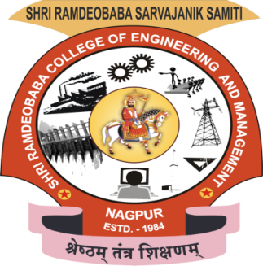
Project Seminar on
IOT based Automated Hydroponics
Cultivation System
in partial fulfillment of
VII Semester Bachelor of Engineering (B.E.)
in
Electronics Engineering
PROJECT PHASE- I (ENP 406)
Mitali Waghwani A-12
Esha Choudhari A-07
Ketaki Salway C-19
Manish Rai A-41
Guided by
Prof.Snehal Laddha
Department of Electronics Engineering
Shri Ramdeobaba College of Engineering and Management,
Ramdeo Tekadi, Gittikhadan, Katol Road, Nagpur 440013, India.
Session 2019-20

Slide 2
Contents
1. | Introduction
2. | Literature Review
3. | Motivation
4. | Objective
5. | Methodology
6. | Working principle
7. | Software/ Hardware Implementation
8. | Discussion on Results
9. | Conclusion
10. | Future Scope
 | References

Slide 3
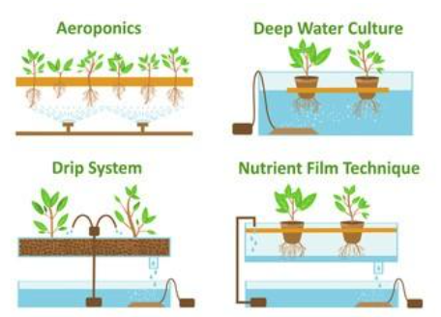
1. Introduction
Hydroponic is a method where the crops are grown in the absence of soil the nutrients that are acquired from the soil are given to them artificially.
Since soil is excluded from production process there will not be any problem related to soil borne diseases, pests and weeds. By the exclusion of these problems, there will not be any usage of harmful plant protection chemicals, so that there is a fresh and healthy yield of crops by the hydroponic method.
Types of Hydroponics Farming :

Slide 4
Literature Review
S.N | Name of Paper | Key points | Author
1. | Towards automated aquaponics: A review on monitoring, IoT, and smart systems(2018) | Hybrid energy control system with a fuel cell and a lead acid battery, | S. Yamaguchi, Yoshihiko Takahashi, Takeharu Hayashi
2. | Fully automated hydroponic system for indoor plant growth(2017) | Smartponics system handled through the web interface, IOT ,sensors. | V. Palandea, A. Zaheera, and K. Georgea
3. | Procedure for the Space Certification of a Controller for Soilless Cultivation (2016) | Aeroponics Farming , IOT | V.Arenella, P., F. Leccese, M.
4. | IoT Based Automated Hydroponic Cultivation System (2019) | IoT ,condition of plants monitored by Sensors and actuators | Sudharsan, V. Raj, Dr. Ponmurugan ,Published 2019

Slide 5
3. Motivation
India’s population is growing at the rate of 1.2% every year. The major necessity of every human being is food. In order to meet up to the food demands of this growing population, it is necessary to implement vertical gardening, which will give optimum produce in a limited space
There are sever drought and flood condition in many states of india like , Bihar, Assam, UP, etc.This has an adverse economic impact on the agricultural sector . As mentioned in the Economic Survey of Maharashtra, there was a 2.7% decline in the economy of agriculture sector .
However, if the above-mentioned technique is implemented, the farmers shall not remain dependent of the climatic changes, lack of water and challenges faced due to fluctuating moisture conditions.

Slide 6
4. Objective
To design and develop sustainable IOT Based Automated Hydroponics Cultivation System.
To design and implement hydroponics system using IoT for monitoring various parameters such as pH level of water, nutrients contain in water, temperature and humidity.
This project would be beneficial to conserve water, save space, facilitate a micro climate , produce higher quality food with no harmful pesticides.

Slide 7
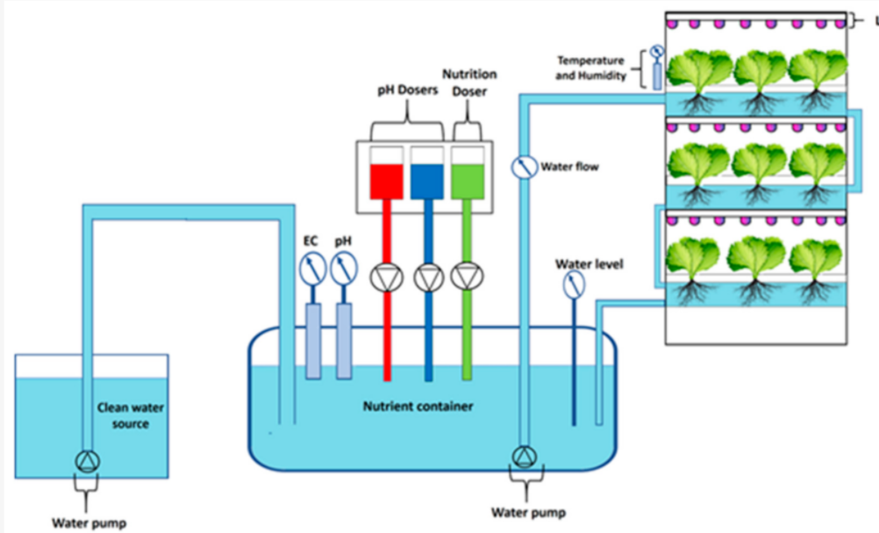
5. Methodology
NFT system for our Project.
Saplings will be Planted in Plastic cups that are placed in PVC pipes.
In that PVC pipes , Nutrient solution will be flowing all over the system for the development of our saplings.
PH sensor for measuring pH value of water.
TDS meter for measuring the amount of dissolved minerals.
Temperature and Humidity sensors for monitoring the enviromental conditions .

Slide 8
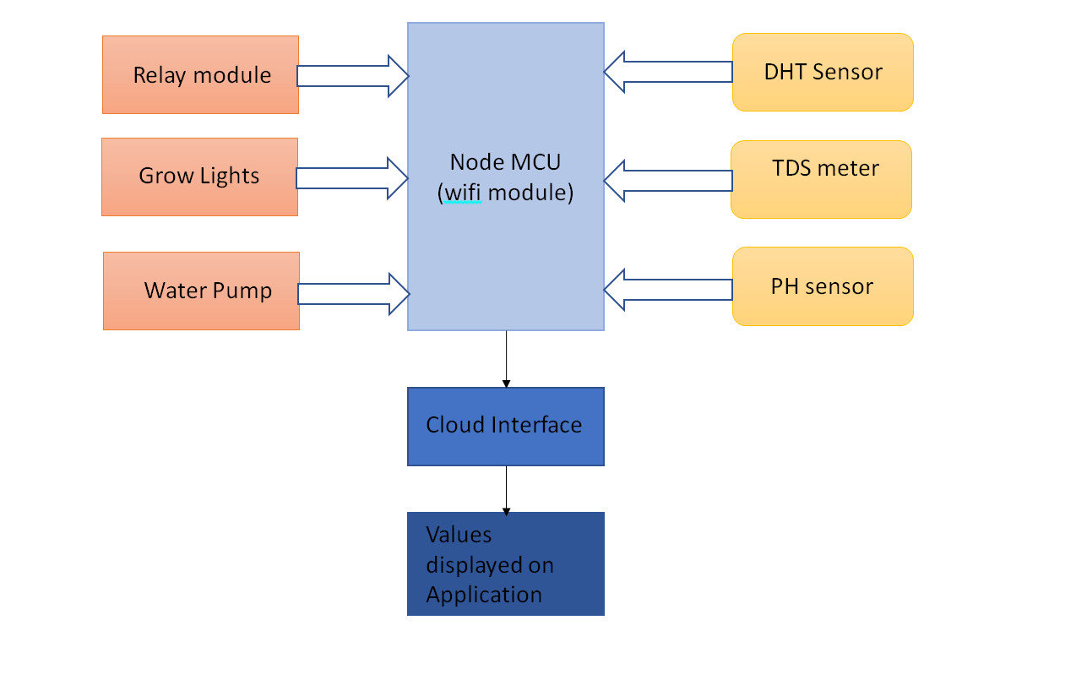
5. Block Diagram

Slide 9
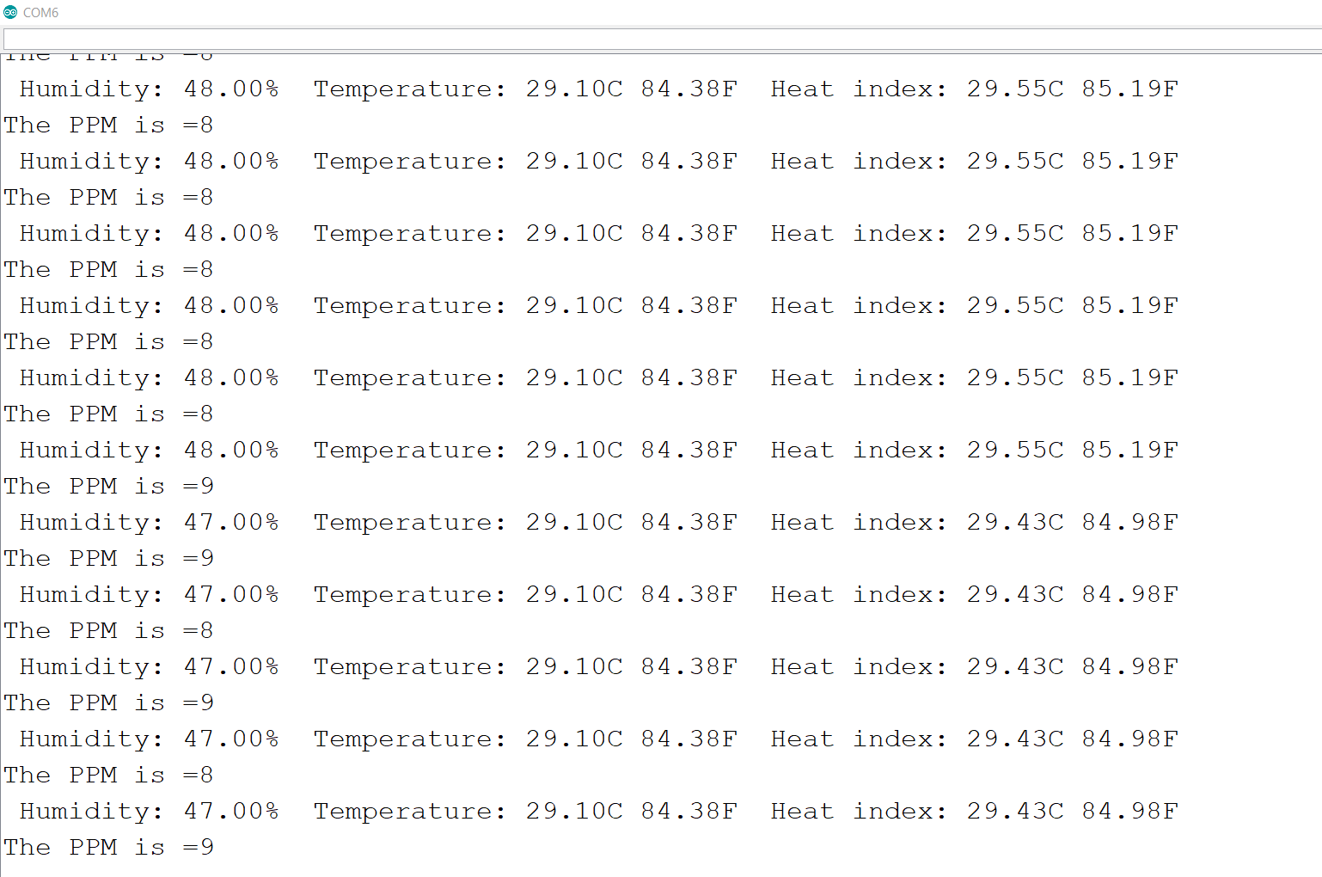
6. Software Implementation
Values of DHT 11 and TDS meter displayed on serial monitor of Arduino IDE.

Slide 10
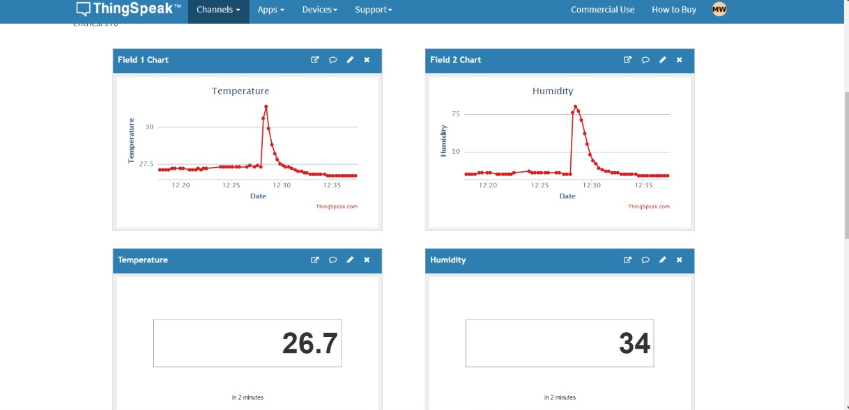
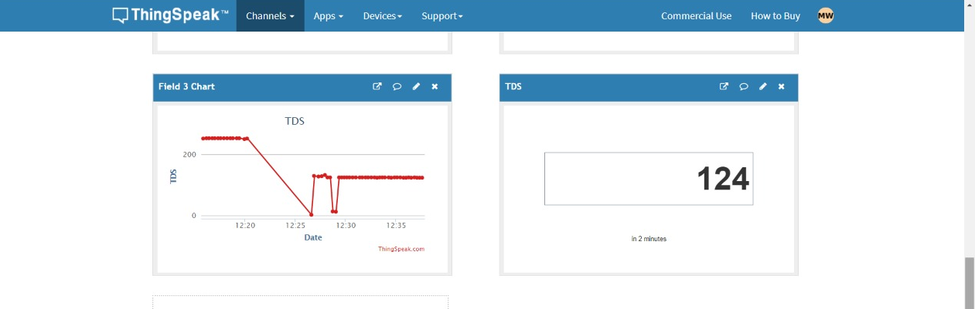
6. Software Implementation
Values of DHT 11 and TDS meter displayed on Thingspeak Cloud Platform.

Slide 11
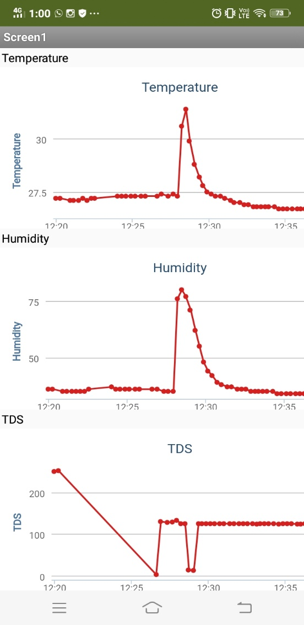
6. Software Implementation
Values of DHT 11 and TDS meter displayed on MIT AI Companion Application on Mobile phone.

Slide 12
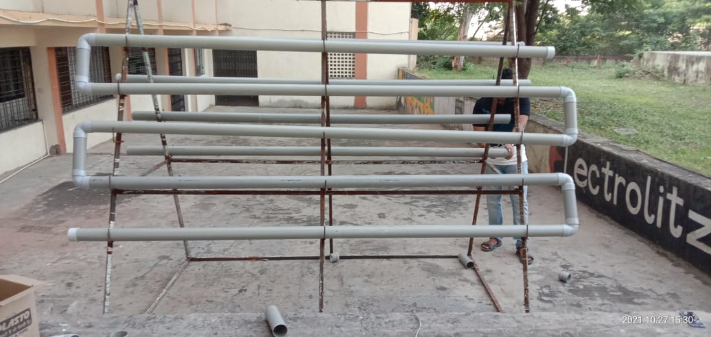
7.Hardware Implementation

Slide 13
8.Advantages
Systems advantages are discussed as follows:
Soil-less agriculture
Plants can grow all year around – both indoors and
outdoors.
Reduces water usage.
Crop yield per area increases due to multilevel
farming.
Plants grow quicker and organic in nature
No need for weeding.
Soil borne pests are eliminated, which means
reduced needs for pesticides.

Slide 14
References
[1] Satoru YAMAGUCHI; Yoshihiko TAKAHASHI; Takeharu HAYASHI- Small indoor hydroponic system with renewable energy,2018.
[2] V. Palandea, A. Zaheera, and K. Georgea: Fully automated hydroponic system for indoor plant growth,2017
[3] V.Arenella, P., F. Leccese, M.Cagnetti: Procedure for the space certification of a controller for soilless cultivation,2016
[4]Sudharsan S1 , Vargunan R2 , Vignesh Raj S3 , Selvanayagan S4 , Dr. Ponmurugan P5 International Journal of Applied Engineering Research ISSN 0973-4562 Volume 14, Number 11, 2019
[5]Akashi Satoh-A hydroponic planter system to enable an urban agriculture service industry,2018.
[6]Glenn Dbritto ; Safa Hamdare- An AI based system design to develop and monitor a hydroponic farm,2018
[7]Helmy ; Marsha Gresia Mahaidayu ; Arif Nursyahid ; Thomas Agung Setyawan ; Abu Hasan-Nutrient film technique hydroponic monitoring system based on wireless sensor network,2017.
[8]Robert Eko Noegroho Sisyanto ; Suhardi ; Novianto Budi Kurniawan- Hydroponic smart farming using cyber physical social system with telegram messenger,2017.

Slide 15
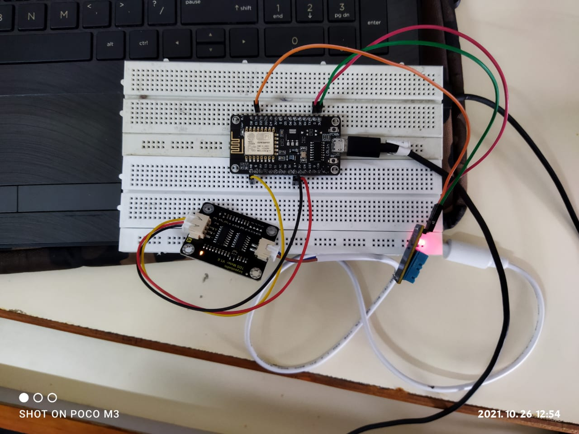
CIRCUIT DIAGRAM

